Slide 1
Project Name : Books wagon
RLL PROJECT GROUP - 5
GROUP MEMBERS: EMPID:
Naveen N K 2584249
Vetriselvan B 2584075
Ramya P M 2583320
Harshitha N A 2584294
Prajwal Diwakar 2583451
Subashree S 2584074
Navin Kiran R 2582868
Shilpa Kumari 2583497

Slide 2

BOOKSWAGON.COM
BooksWagon.com is India’s largest and cheapest online books store which offers more than 40M selections.
This platform offers a huge collection of books from categories like fiction, non-fiction, biography etc. This also offers a collection of Investments, Engineering etc.
This is one of the platform that strive for customer satisfaction by offering a user friendly search engine, effective payment offering and seamless delivery system
Apart from all this, they also provide great deal and discounts on their products.

Slide 3
URL FOR AUT : https://www.bookswagon.com
Functionalities :
Register/Login(Naveen N K )
Personal Settings(Vetriselvan B )
Shopping Cart(Ramya P M )
Search/Refine your Search(Harshitha N A )
Award Winners/Sort By(Prajwal Diwakar )
Request A Book(Shilpa Kumari )
My Wishlist(Navin Kiran R )
Add Address(Subashree S )

Slide 4
INTRODUCTION
In this project we are testing the functionalities of the website: Bookswagon.com
First we have started testing with writing the manual test cases.
The tools and Framework which we have worked with are: Selenium, TestNG, Cucumber.
We have created the extent reports and generated logs.
In our project , we have even used Jira for managing our project.

Slide 5
AGENDA
Selenium
POM Framework
Cucumber
TestNG
Listeners & IRetry Analyzer
Logs
Reports-Extent Reports
TDD
Jira
Outputs

Slide 6

SELENIUM
Selenium is an open-source suite of tools and libraries that is used for browser automation.
It allows users to test their websites functionally on different browsers. Perform Cross browser testing to check if the website functions consistently across different browsers.
It provides a single interface that lets you write test scripts in programming languages like Ruby, Java, NodeJS, PHP, Perl, Python, JavaScript, and C#, among others.
Selenium is very extensible and can be integrated with other tools and frameworks like TestNG, JUnit, Cucumber.

Slide 7
Selenium Suite has 4 components namely:
Selenium IDE
Selenium RC
Selenium WebDriver
Selenium Grid

Slide 8
SELENIUM WEBDRIVER:
Selenium WebDriver is a powerful and enhanced version of Selenium RC which was developed to overcome the limitations of Selenium RC.
WebDriver communicates with browsers directly with the help of browser-specific native methods, there by completely eliminating the need of Selenium RC.
WebDriver works closely with Selenium IDE and Selenium Grid resulting in reliable test execution at speed and scale
Selenium WebDriver is primarily designed to test web applications.
You can perform :
Functional Testing: Test the functionality of web applications by automating user interactions such as clicking buttons, filling out forms, navigating pages, and verifying expected out comes.
Cross-Browser Testing: Test web application for consistency across different browsers and browser versions (e.g., Chrome, Firefox, Edge, Safari)

Slide 9
KEY COMPONENTS
Browser Control: With Selenium WebDriver, you can automate various actions on web browsers such as opening a browser, navigating to URLs, maximizing/minimizing windows, refreshing pages, and closing the browser.
Locating Elements: Selenium WebDriver provides several mechanisms for locating web elements on a page such as ID, class name, CSS selector, XPath, tag name, link text, and partial link text. These locators are used with the findElement() and findElements() methods of the WebDriver interface.
Support for Waits: WebDriver offers explicit and implicit wait mechanisms to handle synchronization issues between the script and the web page. This ensures that the script waits for a certain condition (like the presence of an element) before proceeding further.

Slide 10
Advantages of Selenium for Automated Testing
Language and Framework Support : Selenium supports all major languages like Java, Python, JavaScript, C#, Ruby and pearl for software test automation.
Open Source Availability :The availability of open source code is one of the benefits of Selenium. Selenium is a publicly available automation framework that is free to use because it is an open-source product.
Multi-Browser Support : The Selenium community has been working on improvising every day on one Selenium script for all browsers.
Parallel Testing: Selenium WebDriver enables parallel test execution across multiple browsers or environments, which can significantly reduce test execution time and improve overall test efficiency.
Integration with Testing Frameworks: Selenium WebDriver integrates with popular testing frameworks such as JUnit, TestNG, NUnit, and others. This integration enables efficient test organization, execution, and reporting, enhancing the overall testing process.

Slide 11

POM FRAMEWORK
POM -page object model.​
POM framework" likely refers to Page Object Model framework in software testing.
It is a design pattern commonly used in software test automation To enhance the maintainability, reusability, and readability of automated test scripts.​
It provides a structured way to organize and manage interactions with web pages or user interfaces in an application
The Page Object Model (POM) is a design pattern used in test automation to create an object repository for web UI elements.
The page object model is to represent each web page o UI component As A separate class, known as A "page class“.

Slide 12
USES OF THE POM
It helps in creating reusable code and improves test maintenance by separating the UI locators and methods from the test scripts.
This Design Pattern is used in Selenium where web pages are represented by a corresponding class and web elements are represented by the variables of the class and all interactions are possible through the methods or say functions of the class.
Is a design pattern in Selenium that creates an object repository for storing all web elements.​
It helps reduce code duplication and improves test case maintenance. In Page Object Model, consider each web page of an application as a class file.

Slide 13
Advantages of POM
Code Reusability
Enhanced Test Maintenance : Changes in the UI can be localized to the corresponding Page Objects. When UI elements or workflows change, only the affected Page Objects need to be updated, minimizing the impact on test scripts.
Improved Test Readability : Test scripts become more readable and easier to understand as interactions with UI elements are abstracted into methods within Page Objects. Test cases focus on business logic rather than low-level UI interactions.
Reduced Code Coupling : POM reduces coupling between test scripts and UI elements. Test scripts interact with Page Objects, which handle the details of locating and interacting with UI elements. This separation of concerns makes the codebase more maintainable.

Slide 14
Page Object Model
User Credentials
Username , Password
Test Script
Page Object
getPageObject()
Return the page Object
Login Page
Register Page
Personal settings Page
Search Page

Slide 15

CUCUMBER
Cucumber is a testing tool that helps teams work together to define and automate tests in a language everyone can understand, called Gherkin.
It's great for Behavior-Driven Development (BDD), where tests are written in a way that mirrors how users interact with the software
Key features of cucumber
Feature Files: These are where test scenarios are written in a human-readable format using Gherkin syntax.
Step Definitions: Step definitions link the scenarios described in feature files with the actual test implementation.
Tags: Tags are used to organize and selectively run tests, providing flexibility and control over test execution.
Reporting: Cucumber generates detailed reports that offer insights into test execution results, helping teams make informed decisions.

Slide 16
Feature Introduction
Every feature file conventionally consists of a single feature. A line starting with the keyword Feature followed by free indented text starts a feature.
A feature usually contains a list of scenarios. scenarios together independent of your file and directory structure.
Given
When
Then
What software will
Look like to user
Things that the user will do
what the user should expect

Slide 17
Advantages of using cucumber
Collaboration: Facilitates effective collaboration between technical and non-technical stakeholders by providing a common language for defining and verifying system behavior.
Reusability: Promotes modularity and reusability of test scenarios, allowing teams to efficiently reuse test cases across multiple test suites, reducing duplication and enhancing maintainability.
Documentation: Generates human-readable feature files that serve as living documentation for the behavior of the system, making it easier to understand the intended functionality and aiding in knowledge transfer among team members.
Early Bug Detection: Enables automated acceptance testing, which helps identify defects early in the development cycle, reducing the cost of fixing bugs and ensuring higher software quality.
Improved Test Coverage: By aligning tests with user stories and acceptance criteria, Cucumber helps ensure comprehensive test coverage, reducing the risk of undetected defects and improving overall software quality.

Slide 18
TestNG
TestNG is an automation testing framework, in which NG stands for “Next Generation”. It is used for the Java programming language, which is inspired by JUnit. It's widely used for testing Java applications, particularly in the context of test automation and software quality assurance.
TestNG is popular among developers and testers because of its flexibility, ease of use, and powerful features for writing and executing tests.
Features of TestNG:
Test Suites
Annotations
Parameterized Testing
Parallel Execution
Listeners
Assertions
Reporting

Slide 19
Test Suites: TestNG allows us to organize your tests into logical groups called test suites. Test suites can include multiple test classes and define the order of test execution, parallel execution, and other configurations.
Annotations: TestNG uses annotations to define test methods, setup, and teardown methods. Annotations such as @Test, @BeforeSuite, @AfterSuite, @BeforeClass, @AfterClass, @BeforeMethod, and @AfterMethod help in organizing and controlling the test execution flow.
Parameterized Tests: TestNG supports parameterized tests, allowing us to run the same test method with different sets of data. This is useful for data-driven testing and testing different scenarios with varying input parameters.
Parallel Execution: TestNG provides built-in support for running tests in parallel, which can significantly reduce the overall test execution time, especially for large test suites. we can configure parallel execution at various levels, including methods, classes, and suites.

Slide 20
Listeners: TestNG allows us to define listeners to listen to test events and perform actions such as logging, reporting, or taking screenshots based on test outcomes. Listeners enable custom actions to be executed before or after test execution, providing flexibility in test automation.
Assertions: TestNG provides a wide range of assertion methods for validating expected outcomes in tests. Assertions such as assert Equals, assert True, assert False, assert Not Null.
Reporting: TestNG generates detailed HTML reports that provide information about test execution, including test results, execution times, failures, and errors. The built-in reporting feature helps in analyzing test results, identifying issues, and tracking test coverage.

Slide 21
Advantages of TestNG
TestNG allows users to perform automated testing for web applications.
TestNG enables parallel execution of test methods.
TestNG provides advanced features such as annotations, data-driven testing, parameterization, test sequencing, and parallel testing
TestNG assigns priorities to test methods for controlled execution.
Generates detailed HTML reports for test result analysis.
Offers a variety of assertion methods for validating test results.
It allows defining dependencies between test methods.

Slide 22
LISTENERS
Listeners are TestNG annotations that literally “listen” to the events in a script and modify TestNG behavior accordingly.
These listeners are applied as interfaces in the code.
For example, the most common usage of listeners occurs when taking a screenshot of a test that has failed and the reason for its failure.
Use cases for TestNG listeners
Test execution monitoring: TestNG listeners can be used to monitor the execution of tests, such as logging the start and end times of tests or tracking test results.
Custom reporting: TestNG listeners can be used to generate custom reports that provide detailed information about test execution, such as the number of passed/failed tests or the duration of each test and taking snapshots.
Test failure analysis: TestNG listeners can be used to analyze test failures and provide detailed information about the cause of the failure, such as stack traces or debug information and can be customized for failed test cases retry.

Slide 23
Here are some of the key methods defined in the Itest Listener interface:
On Start(Itest Context context): Invoked before the start of the test suite.
On Finish(ItestContext context): Invoked after the completion of the test suite.
On Test Start(ItestResult result): Invoked before the start of each test method.
On Test Success(ITestResult result): Invoked after a test method passes successfully.
On Test Failure(ITestResult result): Invoked after a test method fails.
On Test Skipped(ITestResult result): Invoked after a test method is skipped.
On Test Failed But Within Success Percentage(ITestResult result): Invoked after a test method fails but within success percentage.

Slide 24
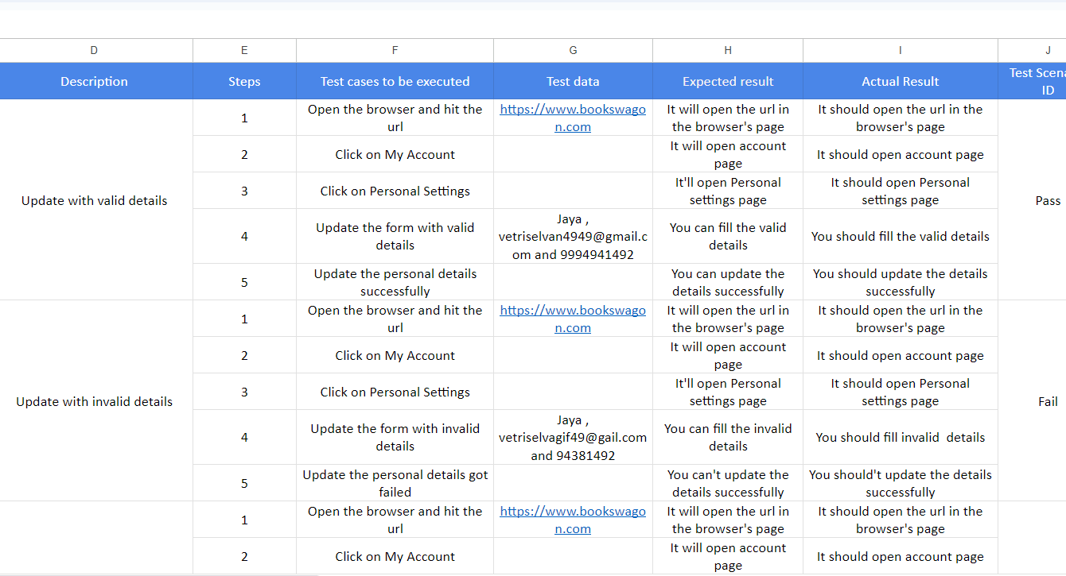
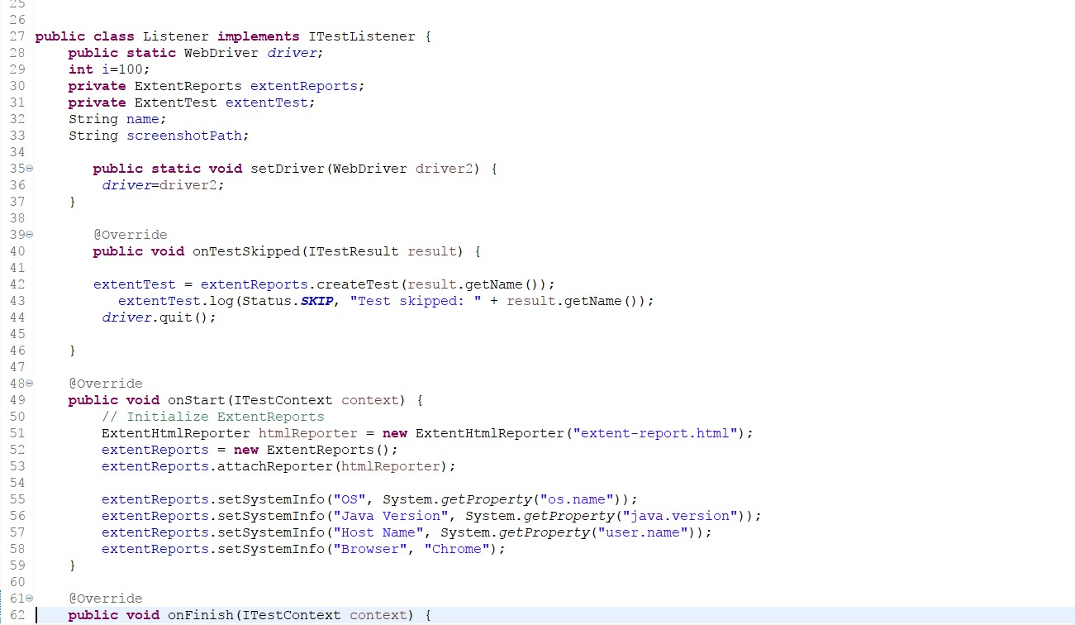
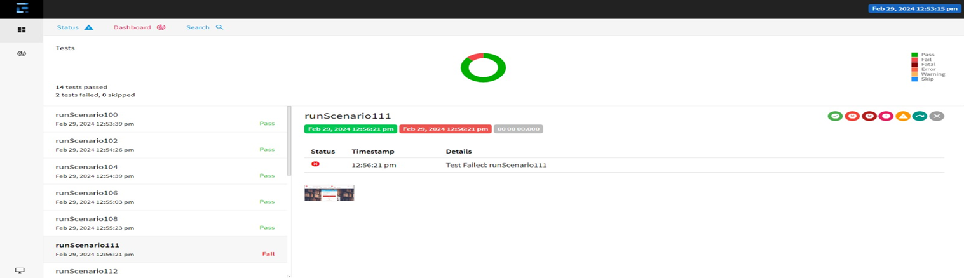
Explanation of listeners
Test cases
Passed
Failed
Skipped

Slide 25
Advantages of Itest Listener
Customized Test Execution: Itest Listeners allows to customize the behavior of your test suite based on various events that occur during test execution.
Enhanced Reporting: With Itest Listeners, you can generate custom reports that provide detailed insights into test execution.
Error Handling and Recovery: Itest Listeners enable you to implement error handling mechanisms to deal with unexpected exceptions or failures during test execution.
Integration with External Systems: Itest Listeners can be integrated with external systems or tools to perform additional actions during test execution.
Flexibility and Extensibility: Itest Listeners offer flexibility and extensibility, allowing you to adapt test suite to evolving project requirements

Slide 26
Implementing ITestListeners in our project
Create a Java class that implements the ITestListener interface. This interface defines methods that will be invoked at different stages of test execution.
Implemented the methods defined in the ITestListener interface to take the screenshots of the failed test cases.
Added the listener class to your TestNG XML file by specifying the name of your listener class within the <listeners> tag.
<listeners>
<listener class-name="filename"/>
</listeners>
Implemented and configured the listener and runned using the TestNG test suite.

Slide 27
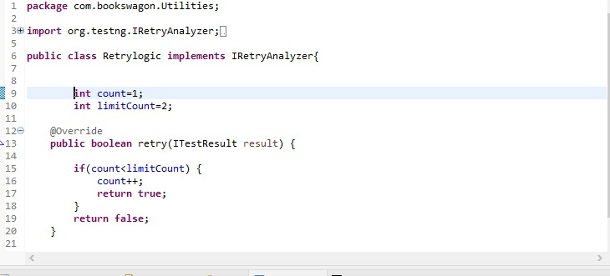
IRetryAnalyzer
IRetryAnalyzer is an interface provided by TestNG, a popular testing framework for Java. It is used to implement custom retry logic for failed test cases.
When a test method fails, TestNG will invoke the implementation of IRetryAnalyzer to determine if the test should be retried.
To associate your test cases with IRetryAnalyzer. In order to do this, you need to use the method below.@Test(retryAnalyzer = Retry.class) public void testCase() { }

Slide 28
Advantages of IRetryAnalyzer
Improved Test Reliability: IRetryAnalyzer allows you to retry failed tests automatically, which can help improve the overall reliability of your test suite.
Reduced False Positives: With IRetryAnalyzer, we can retry tests that fail, reducing the false positives and providing more accurate test outcomes.
Time and Resource Savings: Instead of manually rerunning failed tests, IRetryAnalyzer automates the retry process, saving time and effort for testers and developers.
Increased Test Coverage: By automatically retrying failed tests, we can increase the detection of genuine defects or issues in the application.
Implementation:
Create a Java class that implements the IRetryAnalyzer interface. This interface requires retry() method, which determines whether a failed test should be retried.
Added class to your TestNG XML file by specifying the name of your listener class within the <listeners> tag. <listeners>
<listener class-name="filename"/>
</listeners>

Slide 29
Screenshots
By capturing screenshots , testers can easily identify what and where the test fails during the testing and captures the screenshot only when a test fails.
Call getScreenshotAs method to create image file.
OutputType defines the output type(Failure Screenshot) for the required screenshot.

Slide 30

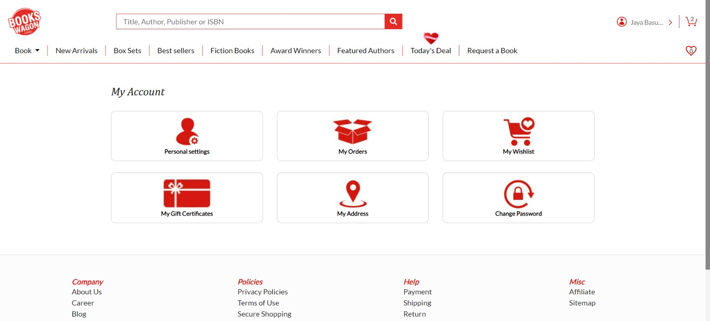

Slide 31
DATA DRIVEN TESTING
Data-driven testing is a methodology in software testing that focuseson using a variety of data inputs to validate the behavior of an application.
Instead of creating separate test cases for each input scenario, data-driven testing utilizes a pool of test data sets to execute tests dynamically.
This approach enhances test coverage and identifies potential issues across different data permutations.

Slide 32
Advantages of Data-Driven Testing
Improved Test Coverage: Data-driven testing allows for testing a wide range of scenarios, increasing the coverage of the application under test.
Reusability: Test scripts can be reused with different sets of data, reducing the effort required for test maintenance.
Scalability: It is easier to scale tests as new data sets can be added without modifying existing test scripts.
Efficient Bug Detection: By testing with various data inputs, potential bugs can be identified early in the development lifecycle.
Flexibility: Testers can quickly adapt to changes by modifying data sets without rewriting test scripts.

Slide 33
Implementing Data-Driven Testing
Identify Test Scenarios: Determine the functionalities of the application that require data-driven testing.
Create Test Data: Prepare a set of input data covering different scenarios, including valid and invalid inputs, edge cases, and boundary conditions.
Develop Test Scripts: Write test scripts that incorporate the test data and automate the testing process.
Execute Tests: Run the test scripts with different data sets to validate the application's behavior.
Analyze Results: Evaluate the test results to identify any deviations from expected outcomes and investigate failures.

Slide 34
Tools for Data-Driven Testing
Selenium WebDriver: A popular automation tool for web application testing, which supports data-driven testing using various programming languages such as Java, Python, and C#.
Apache JMeter: An open-source performance testing tool that allows data-driven testing for web applications, APIs, and databases.
TestNG: A testing framework for Java that supports data-driven testing through parameterization of test methods.
Robot Framework: An open-source test automation framework that provides built-in support for data-driven testing using tabular test data syntax.

Slide 35
DISADVANTAGES
Complex Setup: Setting up a data-driven testing framework can be complex initially.
Initial Time Investment: There's an initial time investment required for framework setup.
Dependency on Data Quality: Test effectiveness depends on the quality of test data.
Maintenance Challenges: Managing numerous test data sets and scripts can pose maintenance challenges.
Increased Initial Effort: Creating parameterized test scripts may require more effort initially.
Data Security Concerns: Use of sensitive information in test data may raise data security concerns.

Slide 36
JIRA
Jira is a popular project management and issue tracking tool developed by Atlassian.
It is widely used by software development teams but can be adapted for various project management purposes.
Jira provides a platform for teams to plan, track, and manage their work using a customizable workflow.
It allows users to create and manage tasks, track issues, and collaborate with team members.

Slide 37
JIRA FEATURES
Issue Tracking: Users can create, prioritize, and assign tasks or issues to team members, making it easy to keep track of work progress.
Customizable Workflows: Jira allows teams to define their own workflows to match their specific processes, ensuring flexibility and adaptability.
Scrum Boards: It supports agile methodologies with features like Scrum boards and Kanban boards to help teams visualize and manage their work.
Dashboards and Reporting: Jira provides customizable dashboards and various reporting options to help teams monitor progress, identify bottlenecks, and analyze project data.

Slide 38
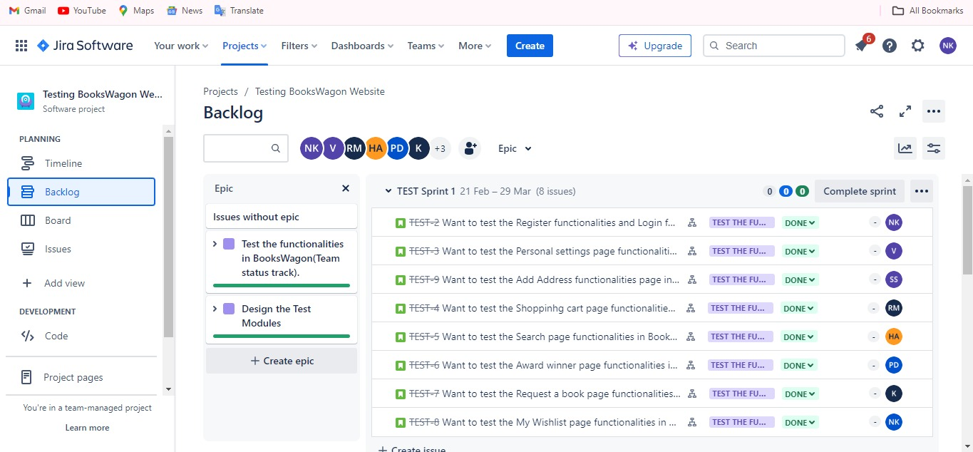

Slide 39
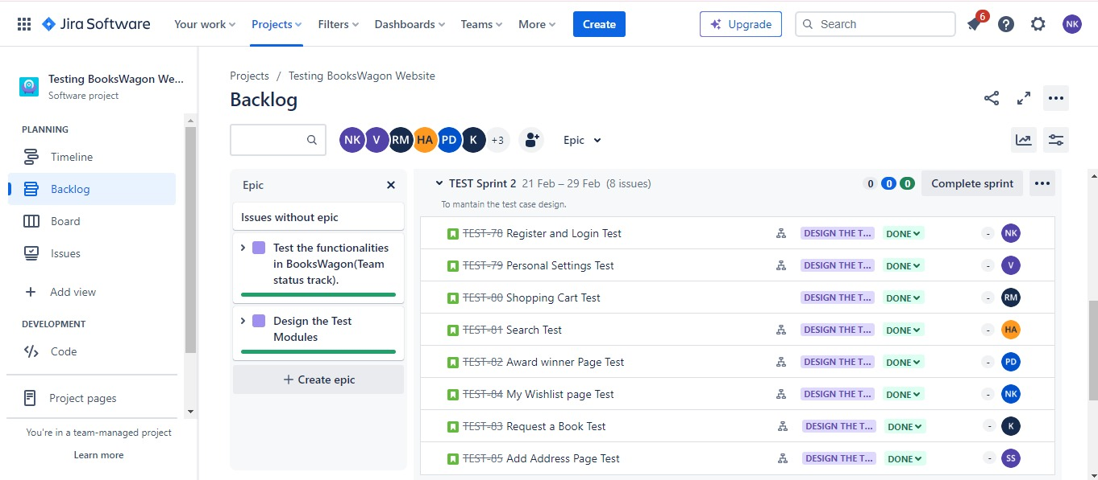

Slide 40
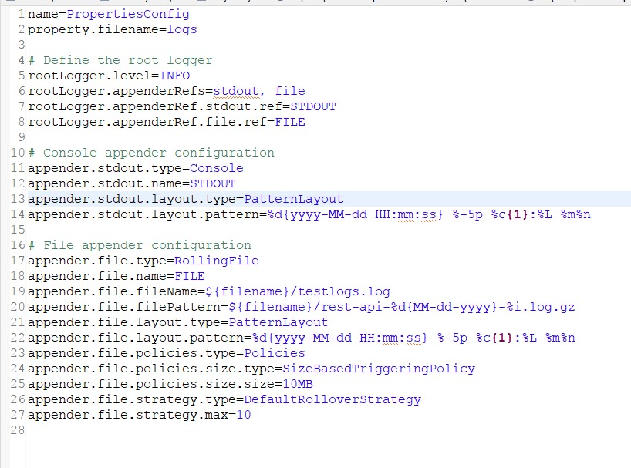
Logs
Log4j2 is a logging library for java applications used to log events errors and other information.
Log4j2 properties file is a configuration file used to specify the settings for Log4j2 such as log levels and out destinations.

Slide 41
Logging Levels: You can specify the logging level for different packages or classes. Log levels include DEBUG, INFO, WARN, ERROR, and FATAL, with DEBUG being the lowest priority and FATAL being the highest.
Output Destination: You can configure where log messages should be outputted, such as to the console, a file, or a database.
Logs in testing capture events, actions, and messages during automated test execution, aiding in debugging and analyzing results.

Slide 42
REPORTS
In Selenium with Java, TestNG provides lot of reports to analyse the results. Like TestNG Reports, Cucumber Reports, Extend Report.
TestNG Reports: TestNG provides default HTML reports that can be generated after test execution. These reports include information about test suites, test cases, pass/fail status, execution time, etc. You can enable TestNG reports by adding the TestNG listeners to your test classes or testng.xml file.
Cucumber HTML Reports: Cucumber itself provides a basic HTML report feature. You can generate HTML reports by using plugins provided by Cucumber. These reports include information about the executed scenarios, step definitions, and their statuses (passed, failed, skipped).
If you need more customized or detailed reports, you can integrate other reporting libraries like “ExtentReports”. These libraries provide more advanced reporting features including screenshots, logging, categorization, and historical data tracking. One of that Custom Reporting is Extent Reports.

Slide 43
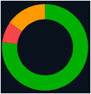
EXTENT REPORTS
Extent Reports is an open source reporting library useful for test automation.
It can be easily integrated with major testing frameworks like Junit , TestNG , cucumber etc.
These reports are mainly HTML documents that depict results as pie charts.
They also shows generation of screenshots , logs and other details.
Once an automated test scripts runs successfully , testers need to generate test execution reports in order to understand clearly about the results. The Dependency we are adding to generate is
<!-- https://mvnrepository.com/artifact/com.aventstack/extentreports -->
<dependency>
<groupId>com.aventstack</groupId>
<artifactId>extentreports</artifactId>
<version>5.1.1</version>
</dependency>

Slide 44
Advantages of Extent Reports
HTML Reports : HTML reports provides a detailed view of test execution and makes easy to understand test results
Real-Time Reporting : It provides real time updates during test execution as tests are running the reports are updated dynamically allowing testers to monitor progress and identify issues as they occur
Screenshots and log Information : Allows testers to attach screenshots or log messages to each step of the test its makes better understandable the flow of test execution
Supports for Multiple platforms : It supports multiple testing frameworks and platforms including TestNG , Junit and others it also makes suitable for automation projects

Slide 45
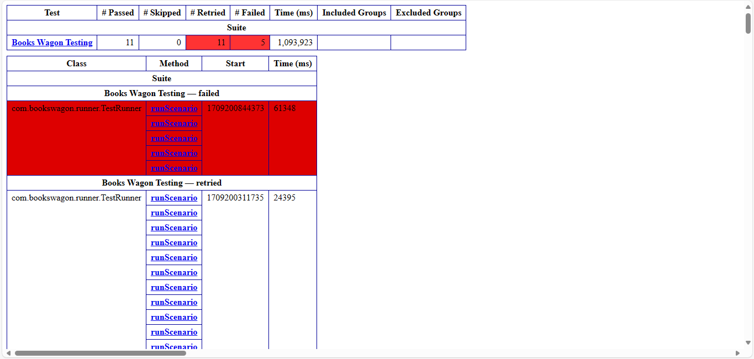
Outputs

Slide 46
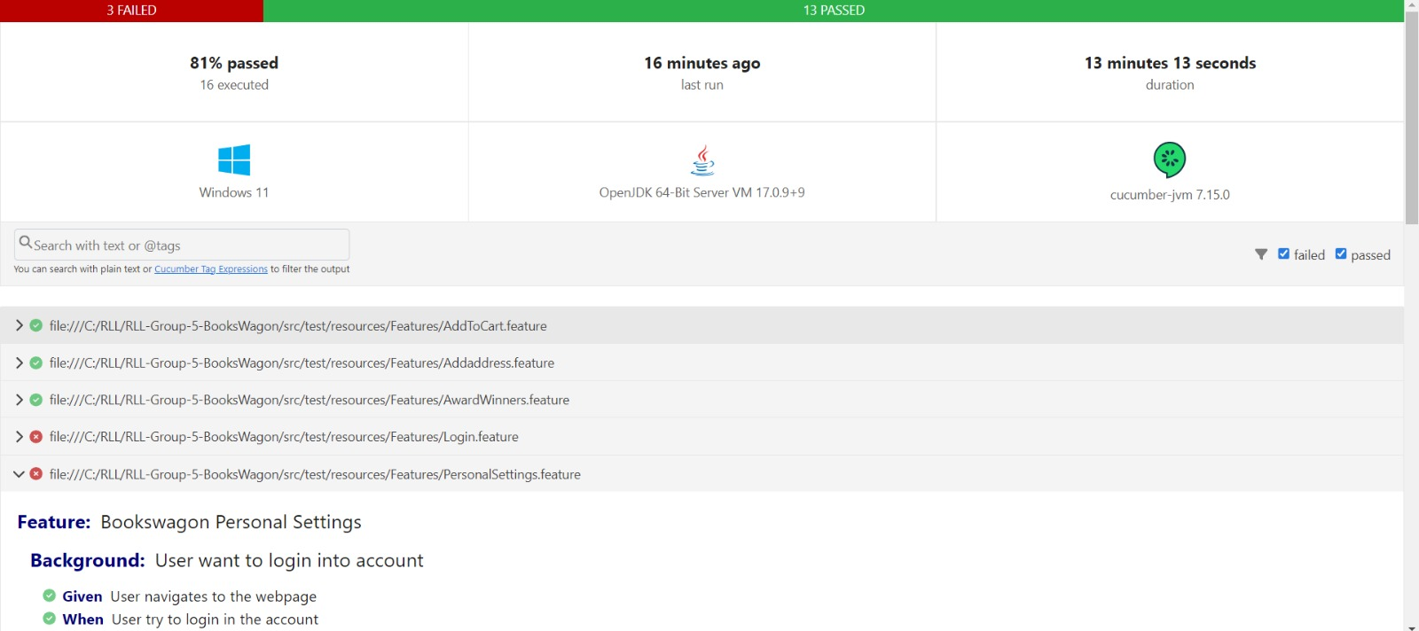

Slide 47
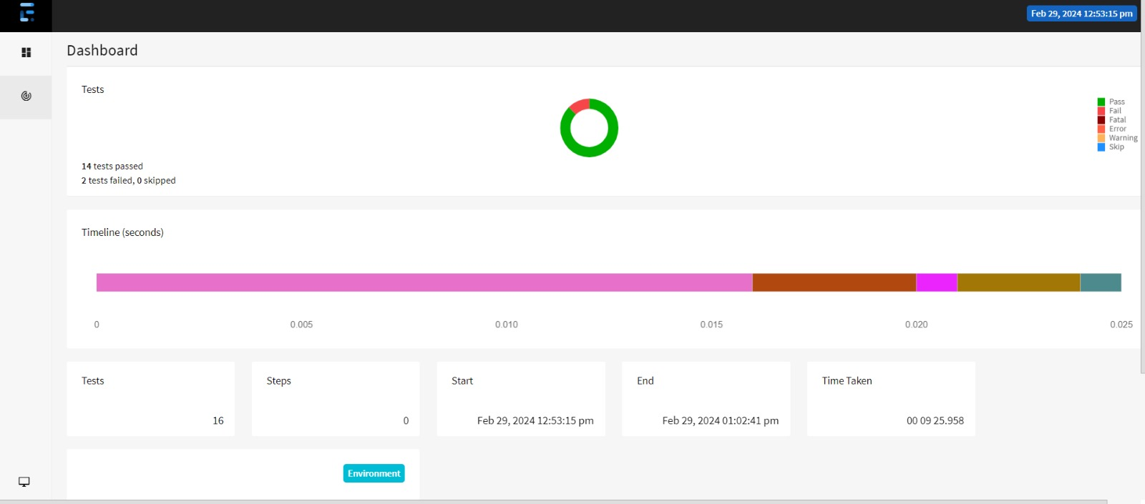

Slide 48


Slide 49
THANK YOU TEAM

